Slide 1






An Introduction to GitHub
October 24th, 2018
Daniel Alexander
Federal Statistical Research Data Center
R-Squared
CISER-in-the-Cloud
Cornell Restricted Access Data Center
CISER Data Archive

Slide 2
What is Git
GitHub is a web-based Git or version control repository and Internet hosting service. It is mostly used for code. It offers all of the distributed version control and source code management (SCM) functionality of Git as well as adding its own features. It provides access control and several collaboration features such as bug tracking, feature requests, task management, and wikis for every project.

Slide 3
Basic Git Features
Git picture
init
add
diff
ignore
push
commit
clone
pull
checkout
merge

Slide 4
Basic Git Features
Init
Add
Creates a new repository
Adds a file to a repository to be tracked

Slide 5
Basic Git Features
Diff
Ignore
Checks differences between two files/versions
Ignores a file from the repository’s folder
Useful when you want to add all to the repository and don’t care that there are files that will be different, or want to track the changes of these files

Slide 6
Basic Git Features
Commit
Push
Creates a new snapshot or reference point to restore files to
Creates a new version online. Similar to a commit, but different

Slide 7
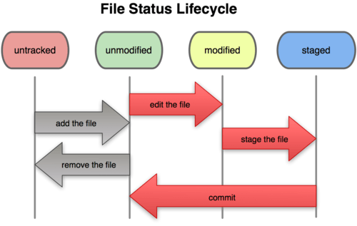
Understanding Commit & add
https://git-scm.com/book/az/v1/Git-Basics-Recording-Changes-to-the-Repository

Slide 8
Basic Git Features
Clone
Pull
Creates a copy of an existing repository
Updates a copy of the repository to be the latest pushed version

Slide 9
Basic Git Features
Checkout and Branch
Merge
Checkout allows you to navigate to a different branch.
Branch <name> creates a new branch but does checkout you to that branch (you are still where you used that command)
Merges two branches together, or the main branch and a side one

Slide 10
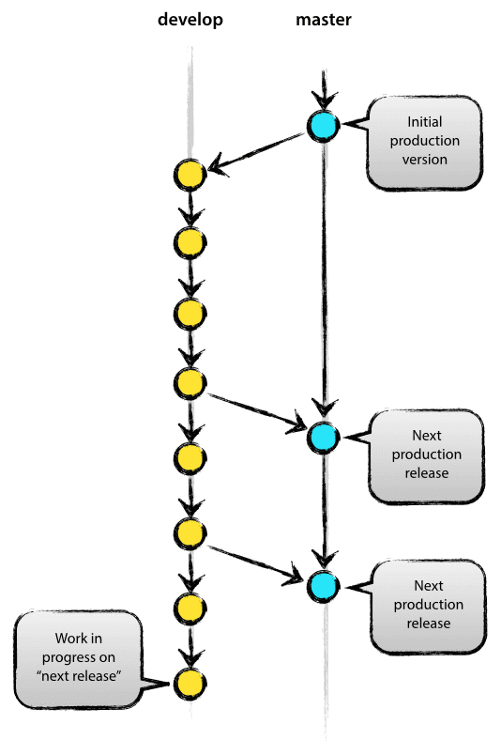
Understanding Branches & Merging
https://nvie.com/posts/a-successful-git-branching-model/

Slide 11
What is Github?
An online versioning tool and place to store and collaborate on Git repositories, github has become popular over the years especially with software developers and coders.
This workshop will explore some basic git functionality, as well as setting up a github account and practice using github to move repositories around (cloning them).
Please follow along with me as we go through these exercises.

Slide 12
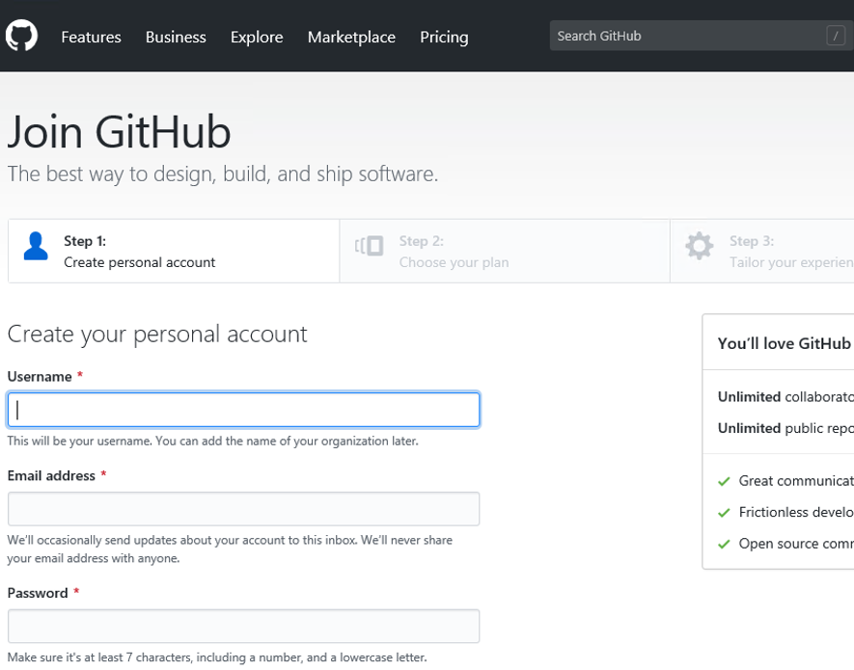
Setting up a GitHub account
Navigate your browser of choice to github.com and click “sign up for GitHub”
Fill out your desired username and contact email, then set a password
Congratulations, you now have a github account!

Slide 13
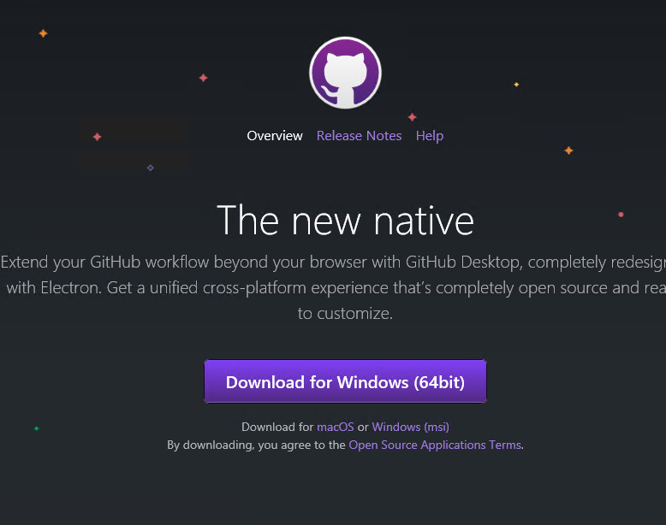
GitHub Desktop
GitHub Desktop works well and is what we will be using for this workshop but there are plenty of other free ones with other features as well as maintaining github integration.
Download and install GitHub Desktop from:
https://desktop.github.com/

Slide 14
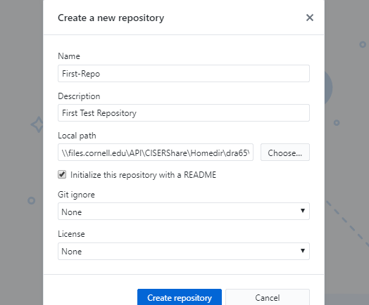
Creating your first repository
Go to File, create new repository
Fill out the fields as you like, but in this example this is how I filled them outName: First-Repo
Description: First Test Repository
Local path: your desktop
Mark the “initialize this repository with a README” button
We don’t want to fill out the Git ignore or license yet so leave them both at none.

Slide 15
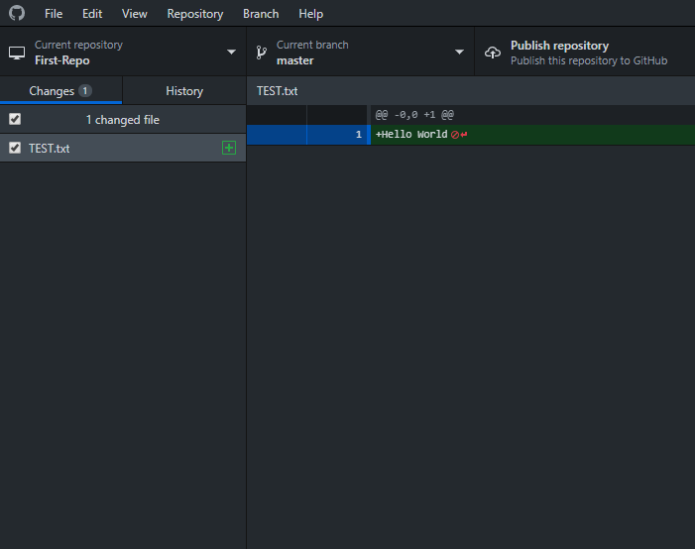
Populating/Initializing Your Repository
You can create a new repository out of a file that is already full of programs, or you can create around an empty folder like we did.
Now we want to fill it with the files we want to version control. Create a new txt document by right clicking, selecting “new” and then “text document” though creating any file you want will work.
Call the new document “TEST” and type “Hello World” as its only line of text.
Your GitHub Desktop should look like the picture on the right

Slide 16
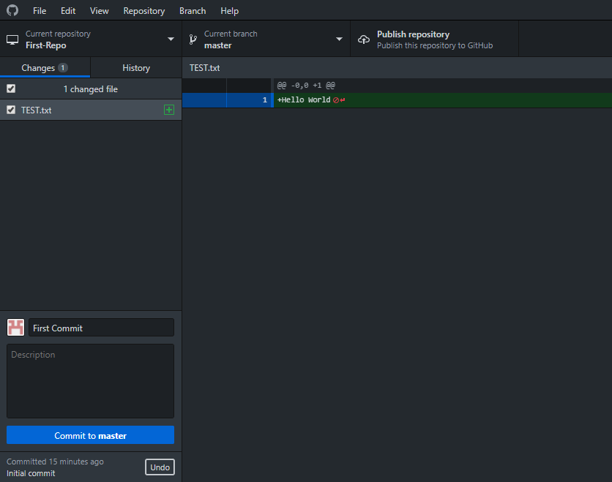
Committing your changes
Now that we made changes that we are happy with we have to commit them in order to ‘save’ them in the repository.
To do so we have to commit. Every commit requires a name, but also has room for a description. You are unable to commit without at least the title of the commit, but is good practice to also have a description.
As this is our first commit, call it “First Commit” and give it any description you want and then click “Commit to master”
After committing, there will be no changes different from the last commit so there will be nothing in changes.

Slide 17
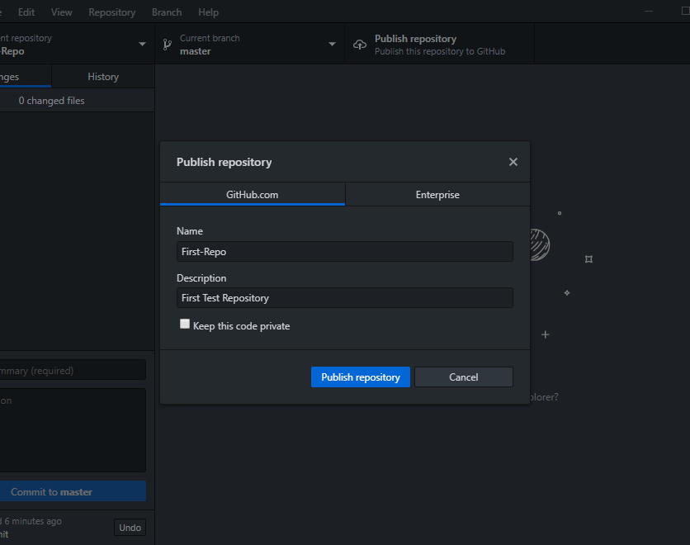
Publish/pushing to GitHub
Now that our repository has something in it with committed changes, we can publish it to GitHub. This will allow us to access it from other computers and to share it with other users. GitHub makes your online repositories public unless you pay, but there are other free Git clients who allow you to have private repositories such as BitBucket. But the process will be similar.
Click the “Publish repository” button
Uncheck “Keep this code private”
Click “Publish repository”

Slide 18
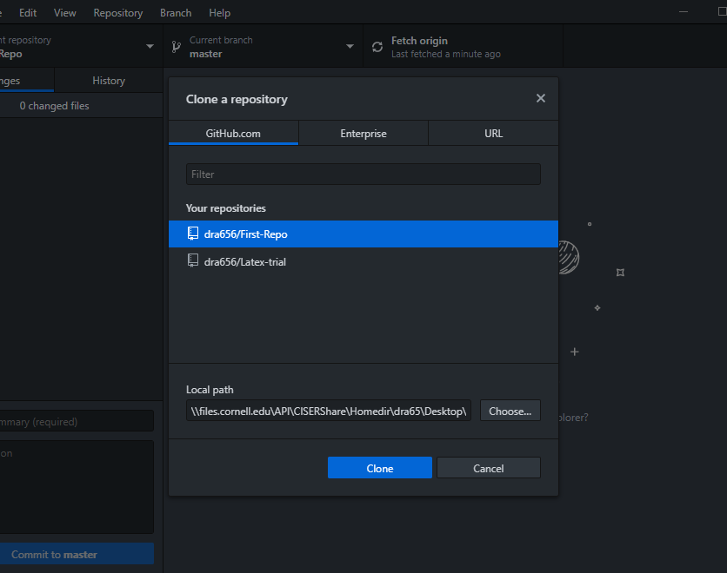
Cloning the repository
Now we can Clone the repository to any computer we want. This allows us to work on the same project from different computers, or easily copy a folder filled with things onto a server.
To clone the repository go to “File” then “Clone Repository…”
You can use a URL or choose from a list of your repositories
Change the “Local path” to a new folder on your desktop titled “Second-Repo”
Make sure “First-Repo” is highlighted and then click Clone

Slide 19
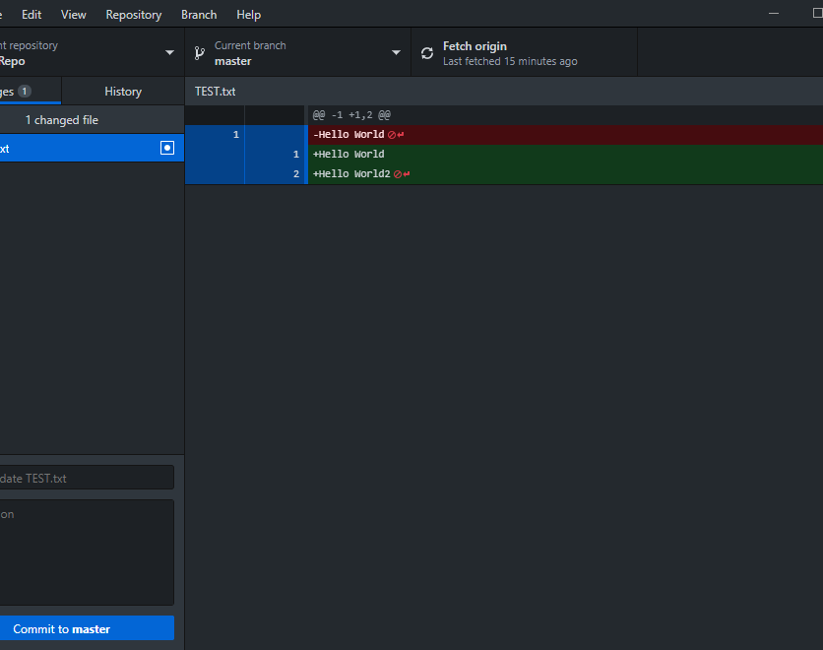
Pushing to GitHub
Now that we have a clone, we can see part of the power of using GitHub and work on this repository in two places
Open up “TEST.txt” in your clone of the repository and add a second line of text to it “Hello World2” to the second line
Commit this change and with a commit summary and description of your choosing
Now the button which was previously called “Publish” is now “Push Origin” with a 1. This shows there is 1 commit on this computer that is not on the Origin. Click this button to update the Origin with your latest changes.

Slide 20
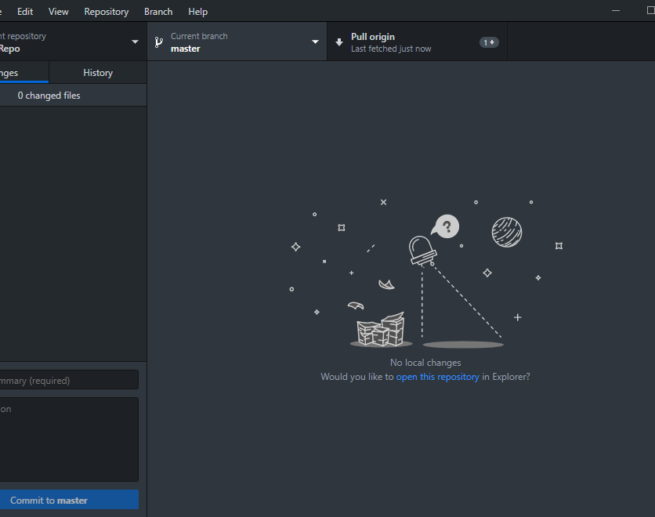
Pulling from GitHub
Now click the “current repository” button and select the other “First-Repo” from the list. The button should say “Fetch origin” again now
Click the “Fetch origin” button. There will be 1 push difference between yourself and the Origin, signified by 1 down arrow
Click “Pull origin”
Now both repository locations are up to date with the latest version
There weren’t any conflicts because we didn’t make any changes in the 2nd repository, but GitHub has ways to resolve those that we will get into shortly

Slide 21
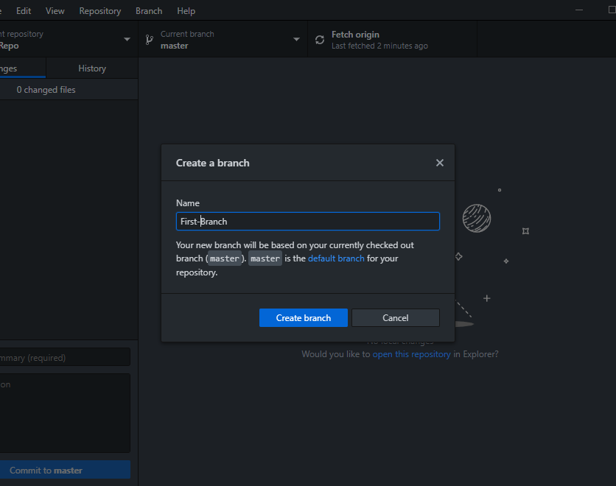
Creating a branch
Branches are useful for working on the same project by multiple teams or when trying to add new features while keeping one stable version.
Creating a branch is as easy as clicking on the “Current branch” button and selecting “create a branch”
Name it “First-Branch” and then click “Create branch”
This allows us to commit changes that won’t affect the master branch until we merge them
You can see that there are no longer an origin on GitHub unless you publish it

Slide 22
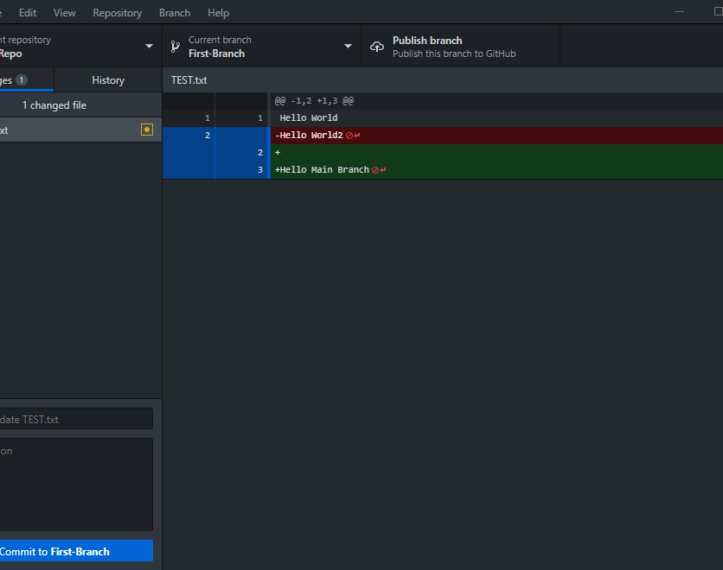
Editing and changing branches
Open up your folder and edit the “TEST” file again and delete the second line and enter in a third line of “Hello Master Branch”
Commit these changes
Now navigate back to the master branch. Notice there are no changes. If you look at the folder and open back up “TEST” than you will see it has those changes undone.
Lets create a conflict to show how github manages that. Edit the “TEST” file and change “Hello World2” to “Hello First Branch”
Commit these changes

Slide 23
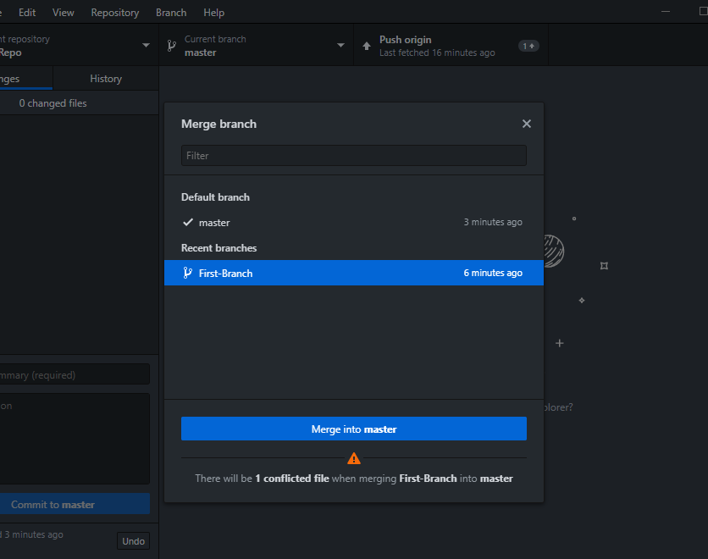
Merging a branch
Now we will merge these two branches together and see what happens when the same file has a conflict.
We will merge “First-Branch” into the master branch, to do so keep the current branch on master and go to “Branch” from the upper menu and click “Merge Branch”
Select “First-Branch” as under Recent branches and “master” as the default. It warns you that there will be 1 conflict but click “Merge into master” anyways
Now we have to manually address the conflicts.

Slide 24
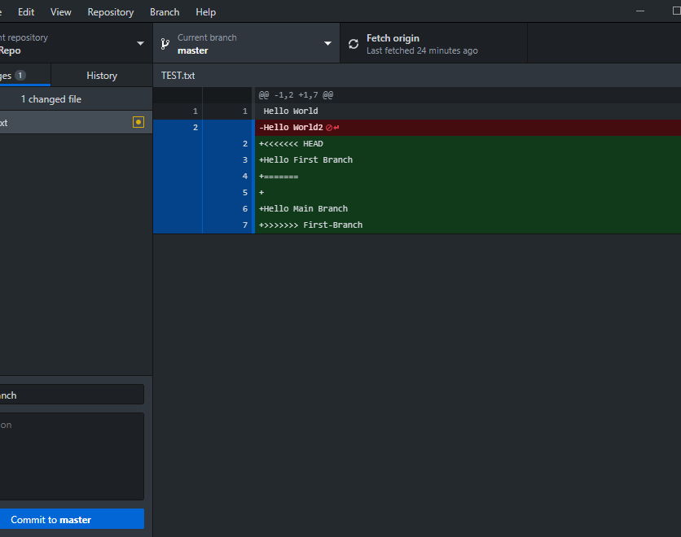
Resolving Conflicts
Now our sample file has issues from the merge. This part can be confusing for new users but it is fairly straight forwards. Git detected that there were conflicts and is allowing you to manually resolve them as it can’t automatically.
The blue signifies what you have highlighted, making it able to choose which line you want to commit.
Red indicates that a line was changed/removed
Green indicates that something was added.

Slide 25
Resolving Conflicts
You may have noticed there are extra lines that we didn’t type.
The new line of “+<<<<<<<HEAD” indicates that is where the head or branch that it was merged into’s changes that conflict begin.
“+=======“ divides the two and thus marks where the branch that was merged from’s changes begin,
and “+>>>>>>>” marks where the conflict ends, followed by the name of the branch that was merged from, in this instance “First-Branch”

Slide 26
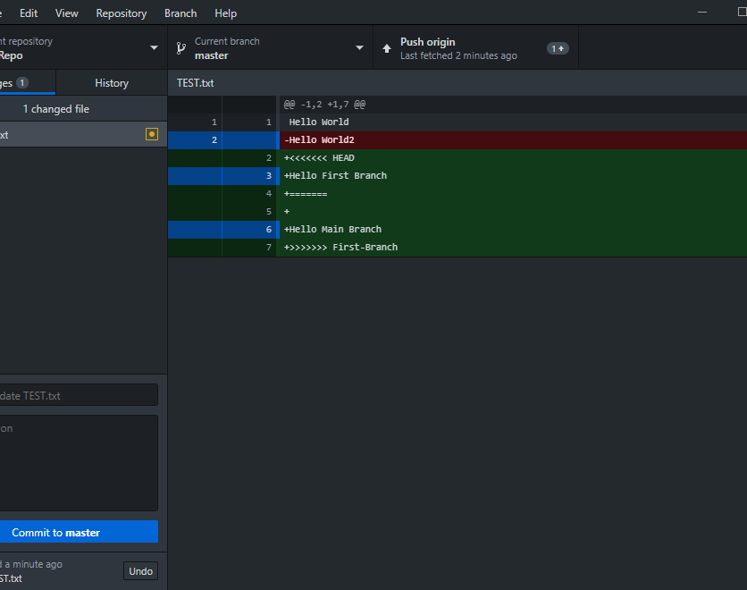
Resolving Conflicts and selective commits
You could just commit all these changes, which keeps this notation intact, however that probably isn’t optimal as you would want to clean up the output later. Instead we will do a selective commit.
To do this we select those changes we want to make and deselect those we do not.
We do want to remove “Hello World2” so make sure that is blue. We also want to add “Hello First Branch” and “Hello Main Branch” so make sure those are blue too. Click everything else so that they are not blue.
Once you are happy with what you have selected, click commit

Slide 27
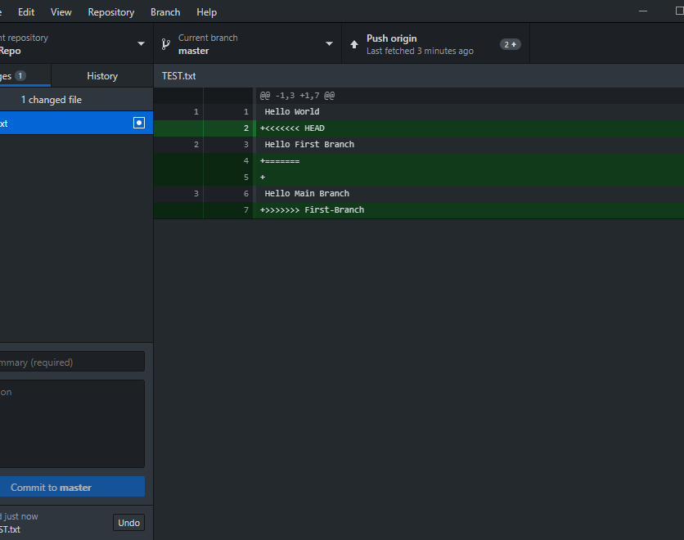
Resolving Conflicts
Now there are still things that we don’t want in our file. To get rid of them we right click on “TEST.txt” and select “Discard changes…”
It will ask to confirm, and so click “Discard changes”
Now all your changes are complete and the branches are merged into master
Open up “TEST.txt” and see how it looks, it should have “Hello World” on the first line, “Hello First Branch” on the second, and “Hello Main Branch” on the third.

Slide 28
Federal Statistical Research Data Center
FSRDC:
A research center managed by the U.S. Census Bureau providing access to confidential internal use files from various federal statistical agencies.

Slide 29
R-Squared
Results Reproduction: Computational reproduction of research results to ensure Reproducibility and Transparency.

Slide 30
CISER-in-the-Cloud
Cloud Computing:
Individual computing space with CISER computing environment for high-capacity computing needs.

Slide 31
Cornell Restricted Access Data Center
CRADC:
Customized secure computing environments for working with restricted research data, meeting individual requirements of each data provider.

Slide 32

CISER Data Archive
Archive:
Extensive, searchable data collection across fields of labor, political, social behavior, demography, economics and health.

Slide 33
MISSION
Anticipate and support the evolving interdisciplinary computational and data needs of Cornell social scientists and economists throughout the entire research process and data lifecycle.

Slide 34
MISSION
Anticipate and support the evolving interdisciplinary computational and data needs of Cornell social scientists and economists throughout the entire research process and data lifecycle.

Slide 35
MISSION
Anticipate and support the evolving interdisciplinary computational and data needs of Cornell social scientists and economists throughout the entire research process and data lifecycle.

Slide 36

THANK YOU
Final message
and/or
Contact information

